Slide 1
CAR PRICE PREDICTION
By Abhinandan D. Kadam

Slide 2
Problem statement
With the covid 19 impact in the market, we have seen lot of changes in the car market. Now some cars are in demand hence making them costly and some are not in demand hence cheaper. One of our clients works with small traders, who sell used cars. With the change in market due to covid 19 impact, our client is facing problems with their previous car price valuation machine learning models. So, they are looking for new machine learning models from new data. We have to make car price valuation model.
I have scraped the data from the well known e-commerce website cardekho.com; where I find some more features of cars to fetch than other sites. As per the requirement of our client we need to build the model to predict the prices of these used cars. In this project I will build various machine learning models sand will check the performance of each and every model. Based on our evaluations finally we will select the best machine learning model.

Slide 3
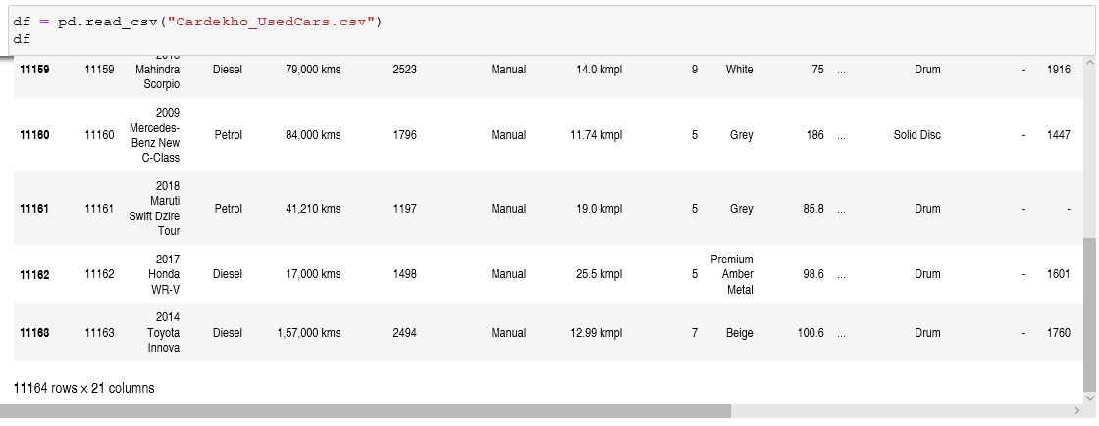
Analytical Problem Framing
I have scraped the required data from cardekho.com with different features and car price as a target variable. And loaded the data into python using jupyter notebook and did analysis.
After loading the .csv file I have saved it into a data frame, we can see the data set is having 11164 rows and 21 different columns. Looking at the data we came to know that we need to go through various data processing, data cleaning as well as feature engineering steps.

Slide 4
Data Processing:
I have checked for duplicate rows and I didn’t found any duplicate row in our data. Many missing values were there and along with that columns have been entered with ‘-‘ and ‘null ‘ values which have been replaced by null values and treated as null values.
There are some columns with continuous data but here it is showing their data type as object type. It is may be because of the presence of some string values between them. That’s why we need to go through data processing.
And I have observed lot of null values from same rows in my data, which may give us trouble in model building, so I will drop some data where column color is having null values, by which we will lose arround 1047 entries but it will lead to a better model.
To convert the data types of the continuous columns from object type to float I did required data processing, to check all those steps please go through github.

Slide 5
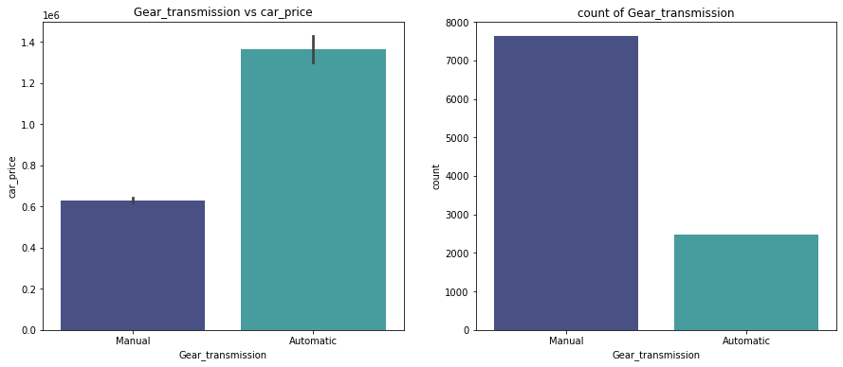
EDA
First plot is representing bar plot for Gear_transmission vs car_price, which will tell us that cars with manual gear transmission system are having less price compared to the cars which are with Automatic gear transmission.
The second graph is count plot of Gear_transmission, by which we can conclude that arround 70% of the cars are with Manual gear transmission system.

Slide 6
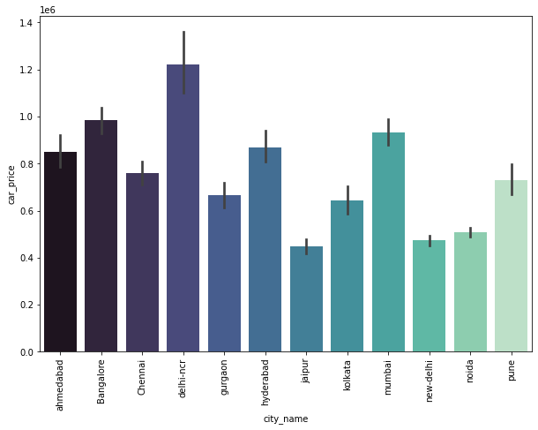
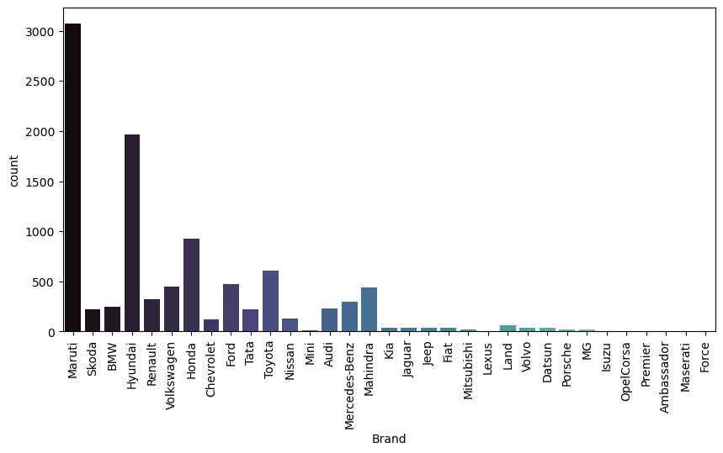
By looking at the first bar plot we came to know that the cars from the city delhi-ncr having higher prices and the cars from the city Jaipur are cheaper than other cities.
The second count plot is for car brand; looking at this plot we can conclude that we are having most of the cars from Maruti and Hyundai brand.

Slide 7
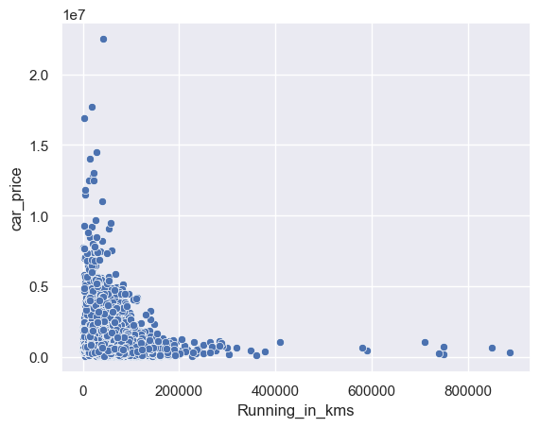
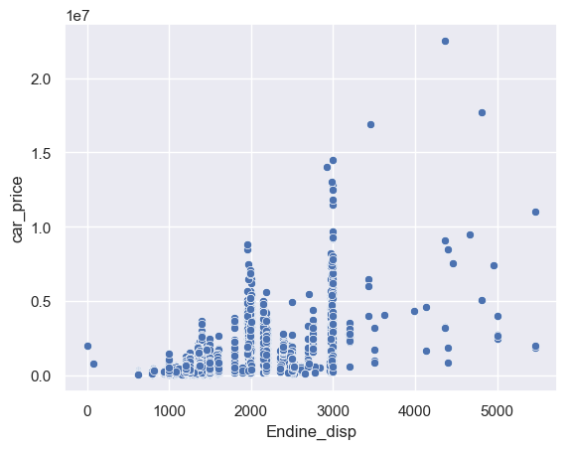
Looking at the firstscatter plot we can say that the prices of cars are higher which are with less running.
The second scatter plot is showing relation between Engine_disp and car_price. Looking at this plot we can say that as engine disp or engine cc increases the price of the car increases. And there are less number of cars which are having engine cc more than 3000.

Slide 8
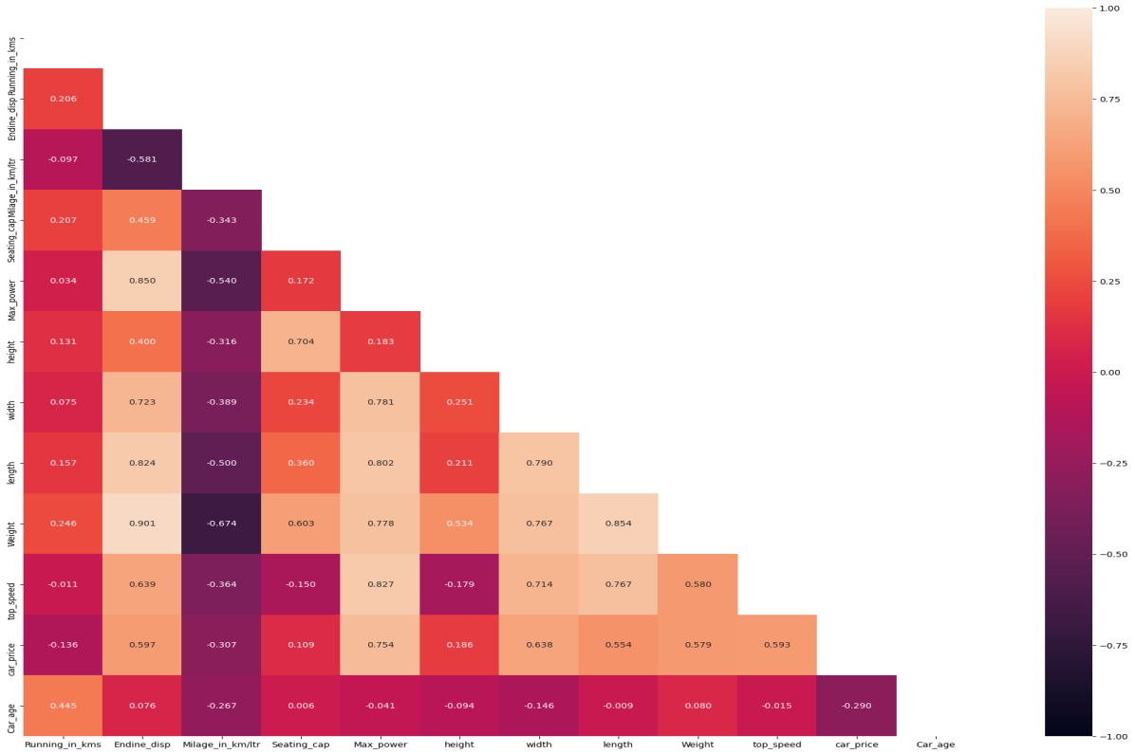
Correlation Heat-map
The above correlation heat-map will tell us that all the features are in good relation with our target variable. Among all these features Max_power and car width are having higher correlation with the target variable.
Other features like Engine_disp, length, weight and top_speed are showing nearly equal relation with target variable. Columns Running_in_kms, car_age and milage_in_kms are negatively related with target variable.It seems like the column Engine_disp and Weight are having maximum coefficient of correlation between each other.

Slide 9
Data Pre-processing Done
Data pre-processing is a very important process of preparing the raw data and making it suitable for a machine learning model. It is the first and crucial step while creating a machine learning model. I have used some following pre-processing steps Filling or Treating Missing values Outliers treatment Encoding using ordinal encoder scaling using standard scaler Skewness treatment

Slide 10
Model/s Development and Evaluation
For this project we need to predict the prices of used cars, means our target column is continuous so this is a regression problem. I have used various regression algorithms and tested for the prediction. By doing various evaluations I have selected ExtraTreeRegressor as best suitable algorithm for our final model as it is giving good r2-score and least difference in r2-score and CV-score among all the algorithms used, other algorithms are also giving me better accuracy but those are differing more between r2-score and cv-scores.
For getting good performance as well as accuracy and to check my model for over-fitting and under-fitting I have used K-Fold cross validation.
I have used following algorithms and evaluated them
ExtraTreeRegressor
RandomForest Regressor
DecisionTree Regressor
LightGBM
LinearRegression
XGBRegressor
From all of these above models ExtraTreeRegressor was giving me good performance.

Slide 11
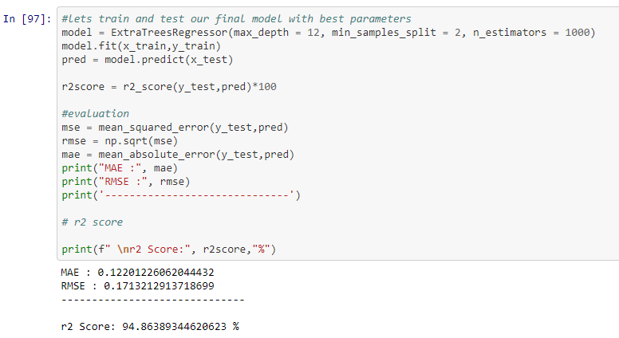
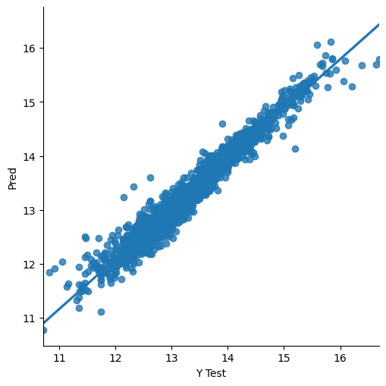
Final Model
Great After doing hyperparameter finally We are getting good r2 score for our final model with satisfactory mae and rmse.

Slide 12
Conclusion
According to this study and analysis of different parameters we got to know that the features like the number of kms that car has driven, Car brands, age of the car, Engine performance, mileage, braking system used are performing important role in predicting the car price.
The manufacturers like Land Rover, BMW, Benz cars are having costliest used cars in the market than other cars. New cars which are having less running are also getting more prices in the market compared to older cars. I have observed that there are huge numbers of cars from Maruti brand selling at lower prices.
We are having cars with different fuel types like petrol, diesel, CNG, LPG and some of the electric cars. Very few cars having CNG, LPG and electricity as the fuel and these are having lower prices in the market when compared to petrol and diesel variant. Also cars with automatic transmission variant are getting more prices in the market.
For this project I have also scraped the car dimensions which are also contributing to the price prediction. Cars with more height and weights are getting more prices than that of with lower height and weights.

Slide 13
Limitations of this work and scope for the future work
As we have scraped this data during the COVID-19 crises; during these days the automotive market is already struggling and it affected the used car prices as well. In future the conditions may be different compared to now, so our model may fail to predict the prices with the same accuracy in the future
And this data is collected from some of the well known cities of India; that means for different cities other than which we have considered the car’s price may vary according to the local conditions.
The car price may affect due to any accident occurred or any kind of external damage which we have not considered here.
So we can say we have to take data on the bases of the respective current situations and feed to this model which will give the results accordingly to that time.

